Slide 1
PROJECT NAME:-
RATINGS PREDICTIONS
SUBMITTED BY:
SHIVAM SHARMA

Slide 2
INTRODUCTION
Problem Statement :
We have a client who has a website where people write different reviews for technical products. Now they are adding a new feature to their website i.e. The reviewer will have to add stars(rating) as well with the review. The rating is out 5 stars and it only has 5 options available 1 star, 2 stars, 3 stars, 4 stars, 5 stars. Now they want to predict ratings for the
reviews which were written in the past and they don’t have a rating.
So, Our goal to build an application which can predict the rating by seeing the review.
Review of Literature
The topic is about to build a Model which can predict the rating by seeing the review as the ratings are from 1 to 5 .
So after seeing the riview the model react how the rating should be assigned for that particular riview.

Slide 3
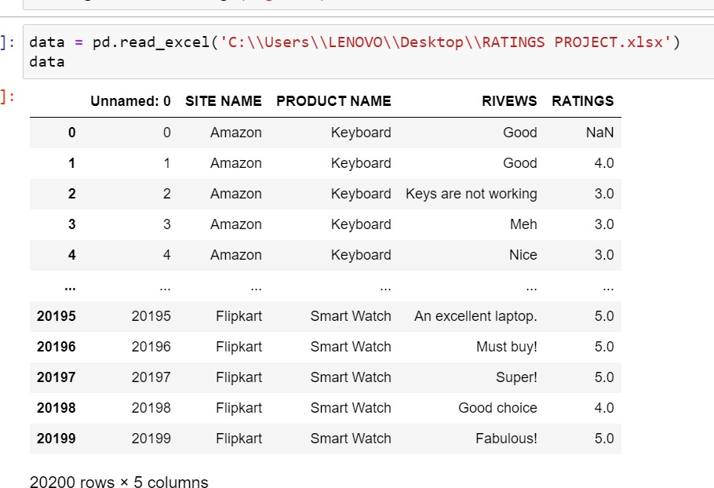
Motivation for the Problem Undertaken
As the e commerce is in very helpful bcz it makes our life easy as well as we can just simply order anything from our homes or from anywhere ,
So public is more reliable on the reviews for any product which is written on the sites . So we build a model so that is is easily predict the Ratings after seeing the reviews wriiten by any customer.
Data Sources and their format
Amazon.com
Flipkart.com
Snapdeal.com

Slide 4
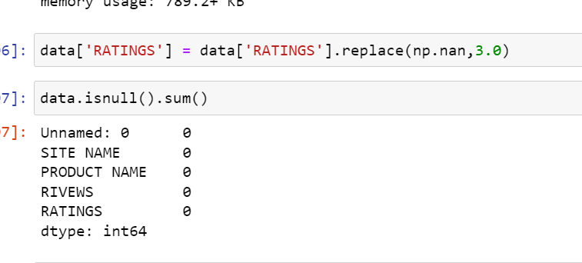
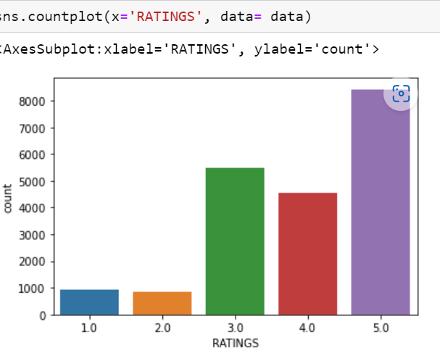
Data Preprocessing and EDA
The steps followed for the cleaning and EDA of the data:-
First we analyse the data by simply data.info() and data.describe() methods so that we can check about the datatypes and checked themean , median and deviation.
After this we check for the null values and there are some some null values present in our rating data so we should fill these nans by fillna method.
3) Then we count the ratings by value_counts method :

Slide 5
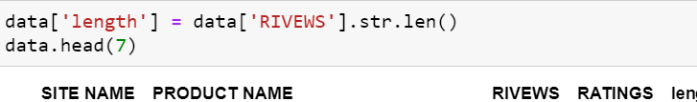
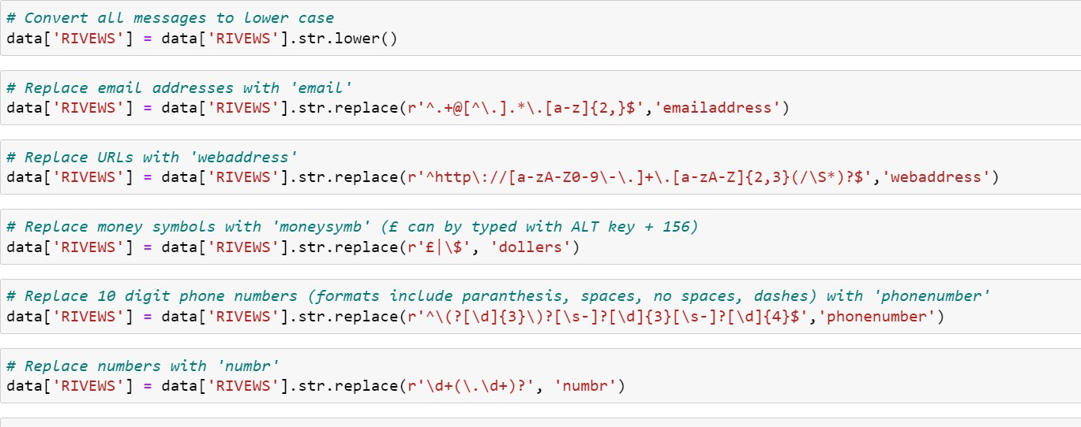
4) Then after we made a new Column of Length which contains the totallength of the Comment ..
5) Then after we Convert all comments in lower case, we replaced email addresses with 'email', URLs with 'webaddress’, money symbols with 'moneysymb' (£ can by typed with ALT key + 156), 10 digit phone numbers (formats include paranthesis, spaces, no spaces, dashes) with 'phonenumber', and numbers with 'numbr'…

Slide 6
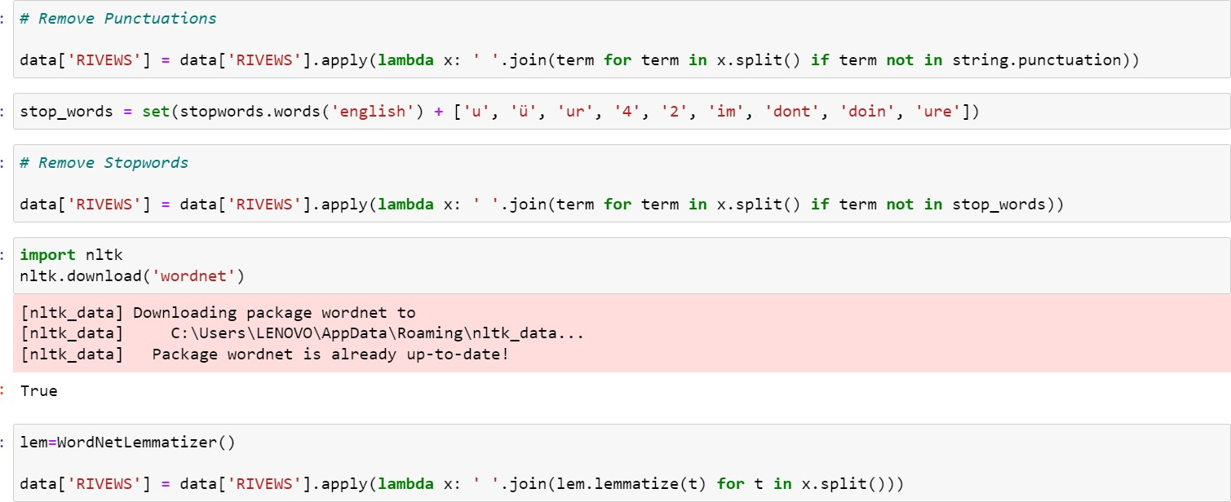
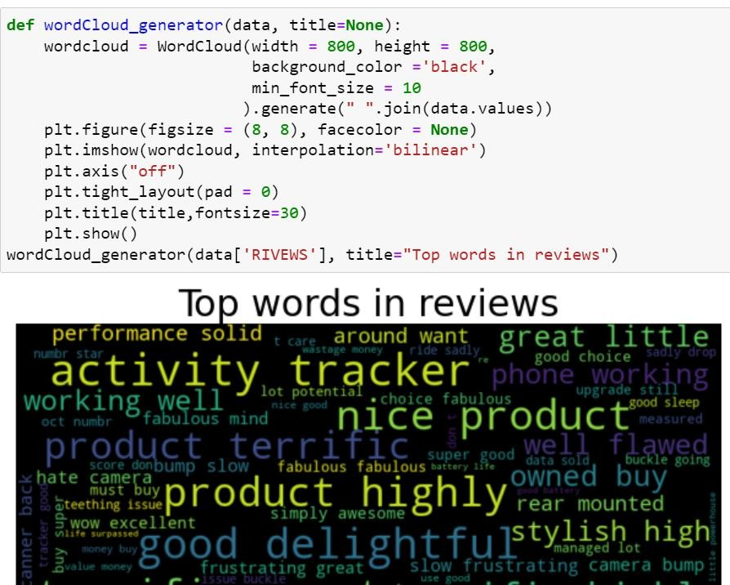
6) Then after we apply lambda function to remove the Stopwords and punctuations from the comment and then we used WordNetLemmatizer so that we can make Lemmas and words can bereduced into their meaningful roots..
Then after lemmatizing the comment we made a new column(name as Clear_lenght) so that we can check the original nad clear length separately by doing these cleanings(like stopwords, punctuations andmany more as written above)..
Then we used wordcloud for some words that are Loud.

Slide 7
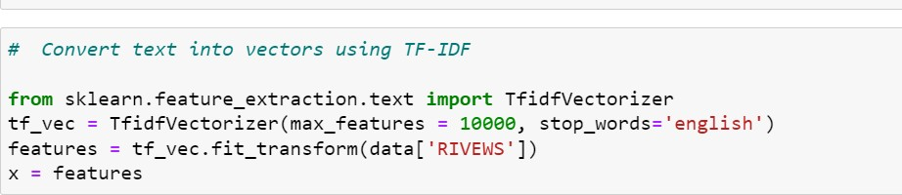
9) Then after this we are ready to convert the comments into the Vector form as machine can not understand object/strings with thehelp of TF-IDF Vectorizer…
10) Now we are ready for the model building..
Algorithm used in this project:-
For building machine learning models there are several modelspresent inside the Sklearn module.
Sklearn provides two types of models i.e. regression and
classification. Our dataset’s target variable is to predict whether fraud is reported or not. So for this kind of problem we use
classification models.
But before the model fitting we have to seprate the predictor and target variable, then we pass this variable to the
train_test_split method
to create the training set and testing
setfor the model training and prediction.

Slide 8
We can build as many models as we want to compare the accuracy given by these models and to select the best model among them.
I have selected 5 models:
MultinomialNB
Logistic Regression
Decision Tree Classifier
Random forest Classifier
Gradient boosting Classifier
BEST Algo. From these And why?
Random Forest classifier is the best algo. From all of these algorithms which is used in this data to predict because the difference between the cross val score and the accuracy score is minimum for the Random Forest algo. and it also gives BETTER ACCURACY(approx. 70%)that’s why we USED THISAlgo.
Lets hypertune this algo with the help of Grid searchCV Lets hypertune this algo with the help of GridsearchCV

Slide 9
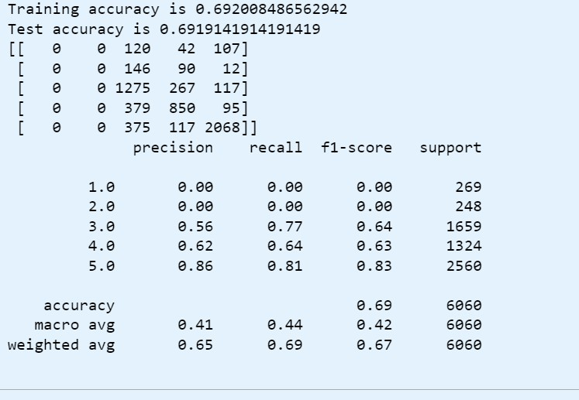
CONCLUSIONS
Save the model for later predictions
# Now my model is ready to predict
So these are the confusion matrix results of the Random algo. Hence my model is ready to predict….

